Slide 1
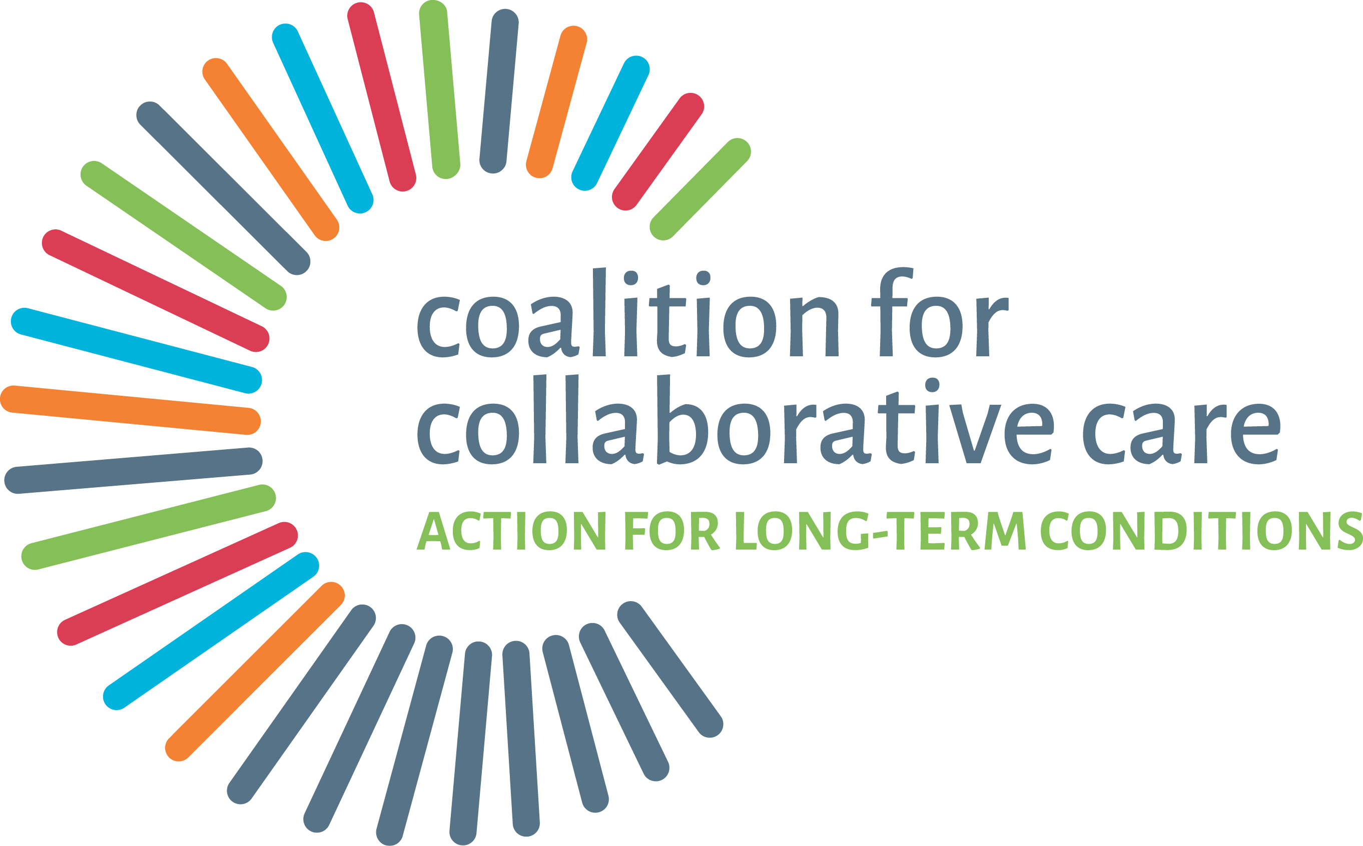

Catherine Wilton – C4CC Director
Mandy Rudzenko – C4CC co-production group

Slide 2

About C4CC – who are we?
A partnership of organisations across health and social care, community and voluntary sector
Hosted by NHS England
Our origins are in the Year of Care for Diabetes and Nesta’s People Powered Health
Launched in November 2014 with about 20 partners
Now have 47 partners, 1800 members/followers, 28 co-production group members and a ‘hub’ team of 6 WTE staff

Slide 3


























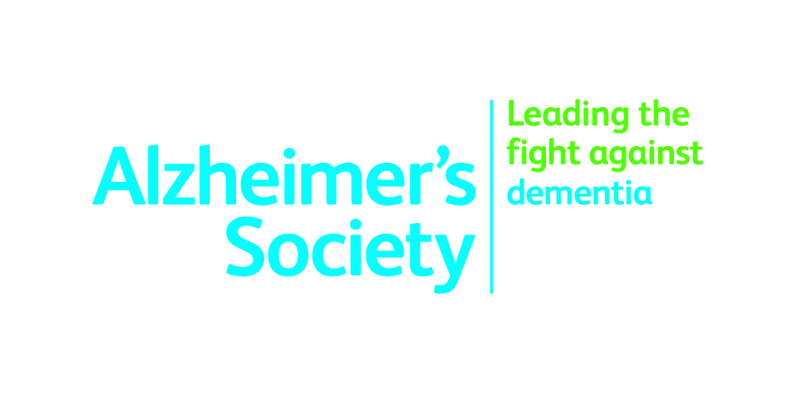





















Slide 4
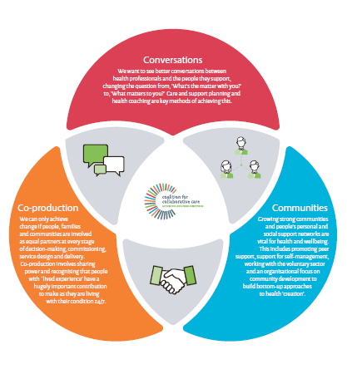
Our vision for the future
We want to see a better deal for people with long-term conditions through:
Better conversations between people and the professionals who support them
Support for growing and nurturing strong communities and social support - vital for wellbeing
Co-production being embedded at every level within the NHS
Notes:
We want to see a better deal for people with long-term conditions through:
Better conversations between people and the professionals who support them
Growing and nurturing strong communities and social support which are vital for wellbeing
Co-production being embedded at every level within the NHS – a truly people-powered system

Slide 5
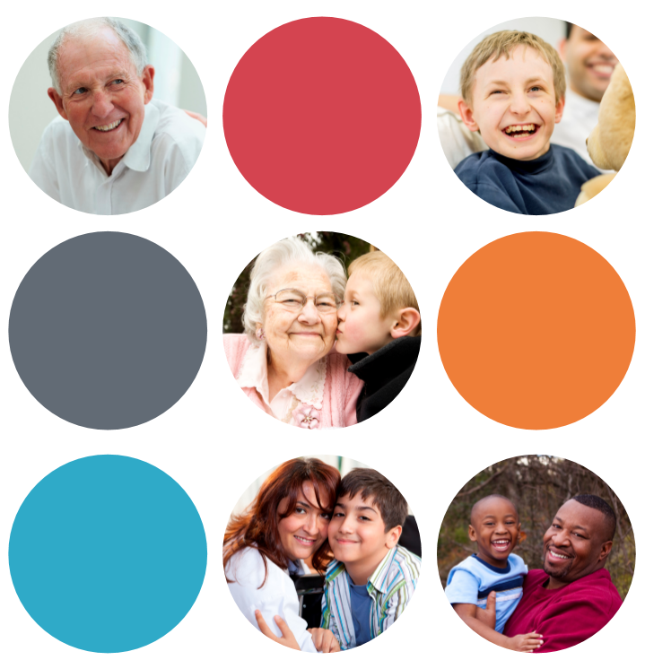
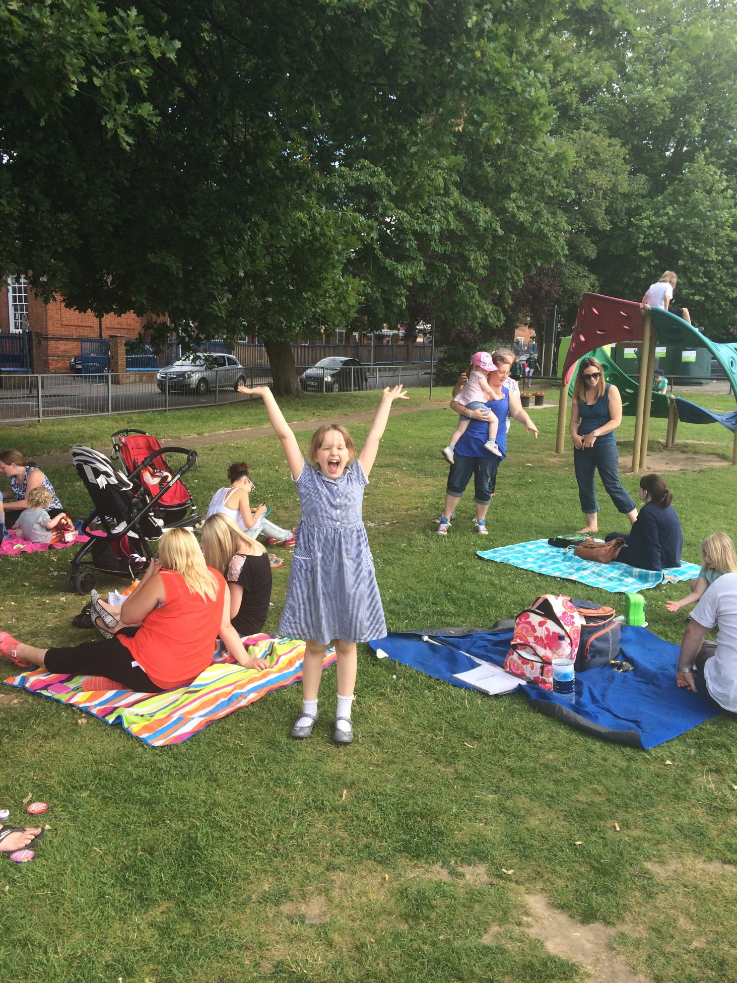
Defining the challenge
Biggest health challenges, and areas of spend, are around managing long-term conditions - around 15m people and 70% of NHS budget
So… an opportunity for new ideas and ways of working…
A different paradigm and a mindset shift – from improving services to improving lives
Doing with and not to - ‘co-creation’
Co-production – valuing people, ‘asset-based’ thinking
Building community capacity, support for self-management, people taking control.

Slide 6
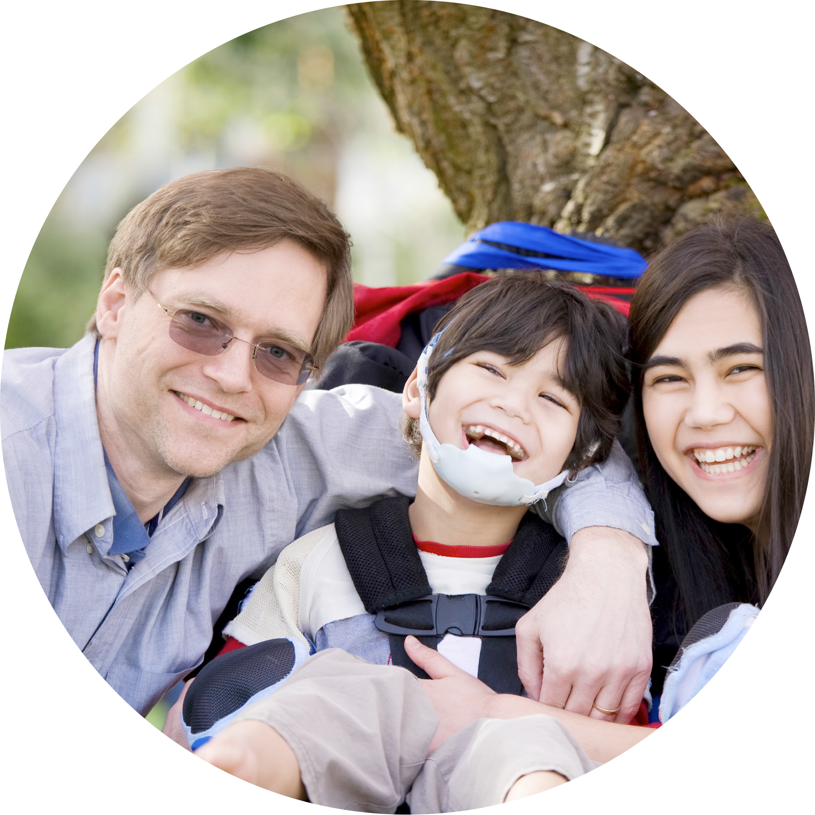
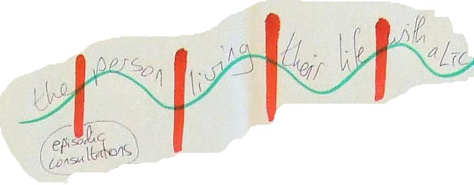
The scale of the challenge
That means a change in:
How professionals are trained
What people can expect from the NHS
How services are organised and joined up
The way the system supports new ways of working.

Slide 7
Addressing the challenge
‘No society has the money to buy, at market prices, what it takes to raise children, make a neighbourhood safe…
…The only way the world is going to address social problems is by enlisting the very people who are now classified as ‘clients’...and converting them into co-workers, partners and rebuilders of the core economy.’ Edgar Cahn

Slide 8
Co-production
“Co-production means delivering public services in an equal and reciprocal relationship between professionals, people using services, their families and their neighbours. Where activities are co-produced in this way, both services and neighbourhoods become far more effective agents of change.”
nef The co-production challenge, 2010

Slide 9
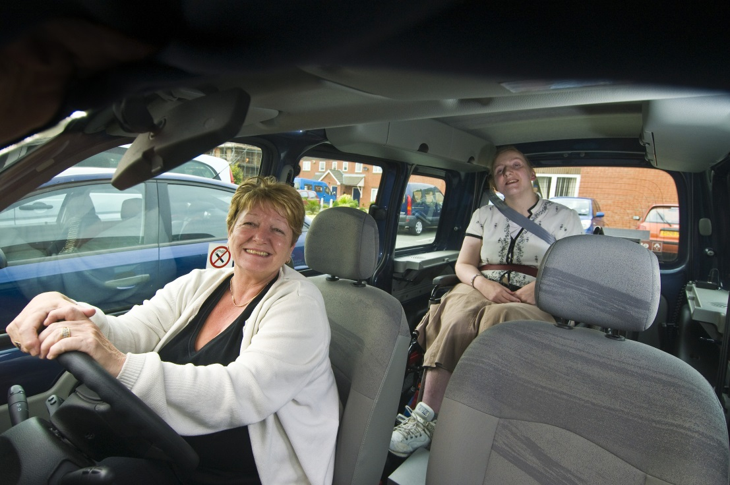
Three levels of co-production
Redefining
1-2-1 - care and support planning, health coaching, connecting people with community activities
Community level - growing new types of services and supports that provide ‘more than medicine’ and build social capital - includes peer support, timebanks, coaching, mentoring, community connecting
Strategic level - involvement of people in co–design, co-commissioning, co-delivery - with a focus on long–term outcomes, recovery and prevention.

Slide 10
Unlocking opportunities
What talent, skill, knowledge, experience or idea have you got that others don’t know about in your organisation that would help us grow this movement for change?

Slide 11
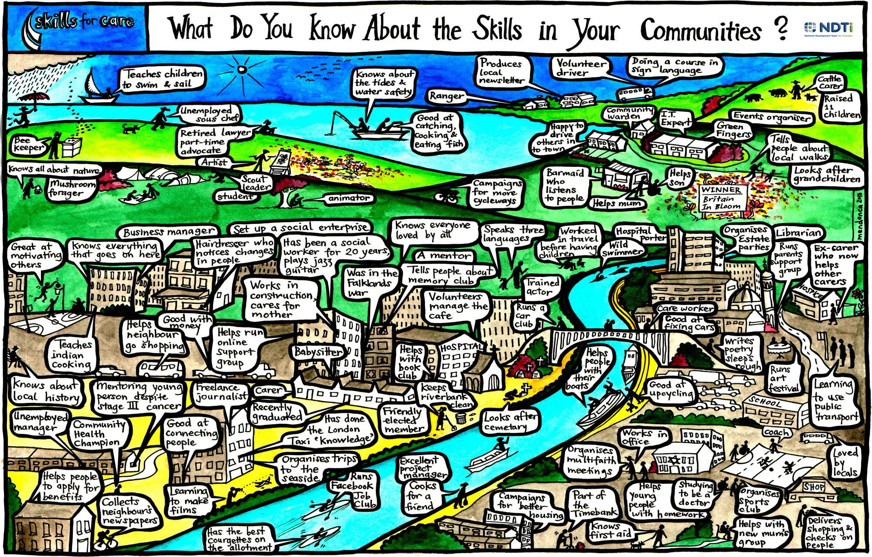

Slide 12
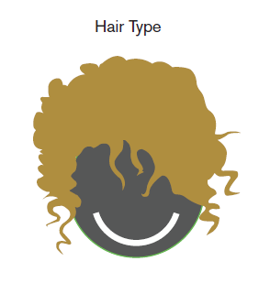

Dynamic social networks
Notes:
What’s the rationale?
I suppose our Connected Communities approach is Community Development 2.0 – developing the community development approach from the perspective of networks and behaviour change.
We are trying to create second order change – it’s not a new way of doing things within the existing framework of how we understand communities, but change as a result of changing the way we understand communities. It is about communities as networks, and about individuals and groups and how the former become the latter.
It is about acknowledging the complexity and emergent properties of networks and deliberately working with it.
Evidence shows that smoking, altruism, obesity, voting behaviour, wellbeing, and so on are all affected by our social networks.
For example, the average risk of smoking is 61% higher if a friend smokes; 29% higher if a friend of a friend smokes; and 11% higher if a friend of a friend of a friend smokes. So it turns out that your husband’s sister’s boyfriend can make you smoke even if you’ve never met them! (To paraphrase Prof Nicholas Christakis who produced this evidence)
Evidence also shows that interventions that deliberately seek to modify peer networks on health issues are more effective than those that do not.

Slide 13
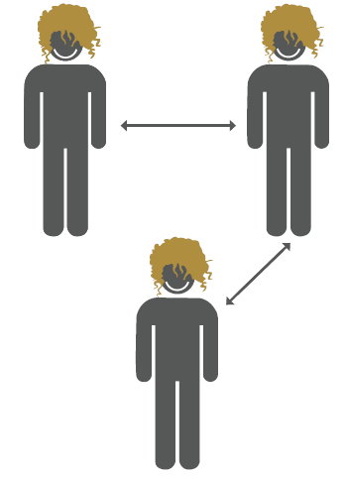
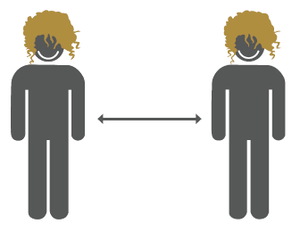
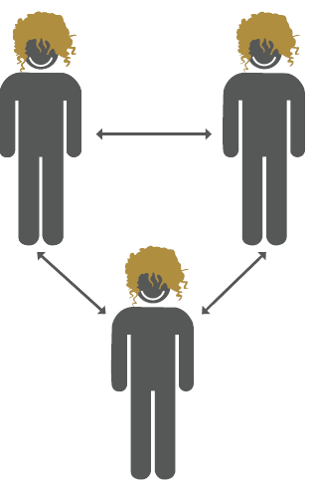
Dynamic social networks
Notes:
What’s the rationale?
I suppose our Connected Communities approach is Community Development 2.0 – developing the community development approach from the perspective of networks and behaviour change.
We are trying to create second order change – it’s not a new way of doing things within the existing framework of how we understand communities, but change as a result of changing the way we understand communities. It is about communities as networks, and about individuals and groups and how the former become the latter.
It is about acknowledging the complexity and emergent properties of networks and deliberately working with it.
Evidence shows that smoking, altruism, obesity, voting behaviour, wellbeing, and so on are all affected by our social networks.
For example, the average risk of smoking is 61% higher if a friend smokes; 29% higher if a friend of a friend smokes; and 11% higher if a friend of a friend of a friend smokes. So it turns out that your husband’s sister’s boyfriend can make you smoke even if you’ve never met them! (To paraphrase Prof Nicholas Christakis who produced this evidence)
Evidence also shows that interventions that deliberately seek to modify peer networks on health issues are more effective than those that do not.

Slide 14
Dynamic social networks
Notes:
[Use the animation on the slide to demonstrate the growth of the snowflake from the initial core team, to professionals recruiting professionals and so on. In the first hospital where the campaign was run 450 people were mobilized]
People: Mike Roes recruited a core team of 8. They then recruited professionals from across all the disciplines in the OR teams – couple of nurses, surgeon, technician, anesthesiologist. They in turn recruited people from their own professions to join the campaign. At each step recruitment took place through relational one-to-ones.

Slide 15
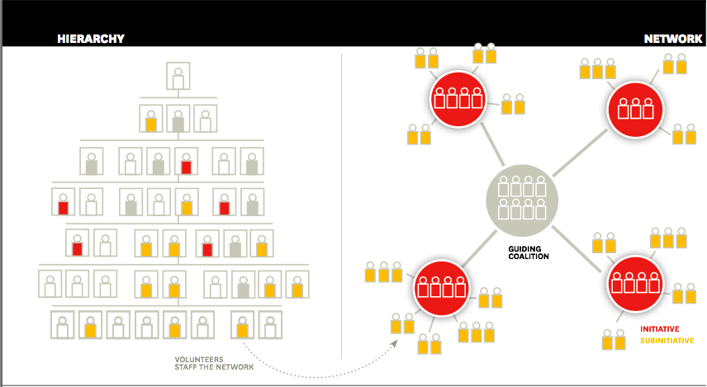
Networks and change

Slide 16
Why co-produce?
“The typical practice (6,300 people) that is in the best quartile for care planning will typically have 35 fewer emergency admissions, 360 fewer outpatient attendances, and 30 additional elective admissions/day cases compared to those in the lowest quartile. This will be a saving to the practice…of around £43,000/year.”
Shirley, T. and Melville, S. (2010),
A New Dialogue with Citizens, London, the Cabinet Office
“The evidence here suggests savings of up to six times the investment made in new approaches – and of course better outcomes for the public.”
Nef: Public services inside out

Slide 17
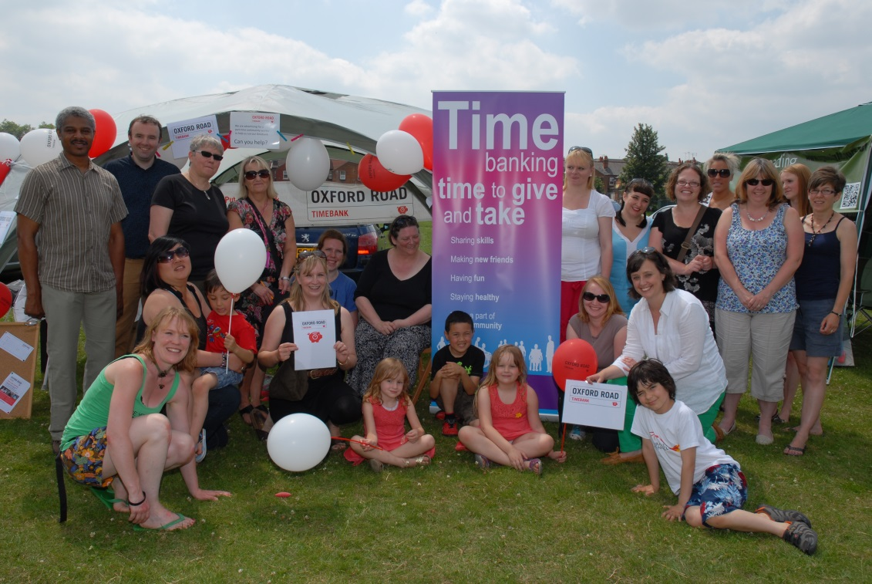
People Powered Health
  Six local teams led by Nesta and the Innovation Unit from summer 2011 to winter 2012.
Annual costs £100-£400 per person
The NHS could save at least £4.4bn a year if it involved people and communities more directly in the management of LTCs
These savings are based on the most reliable evidence and represent a 7% reduction in A&E attendance, planned and unplanned admissions, and outpatient admissions

Slide 18
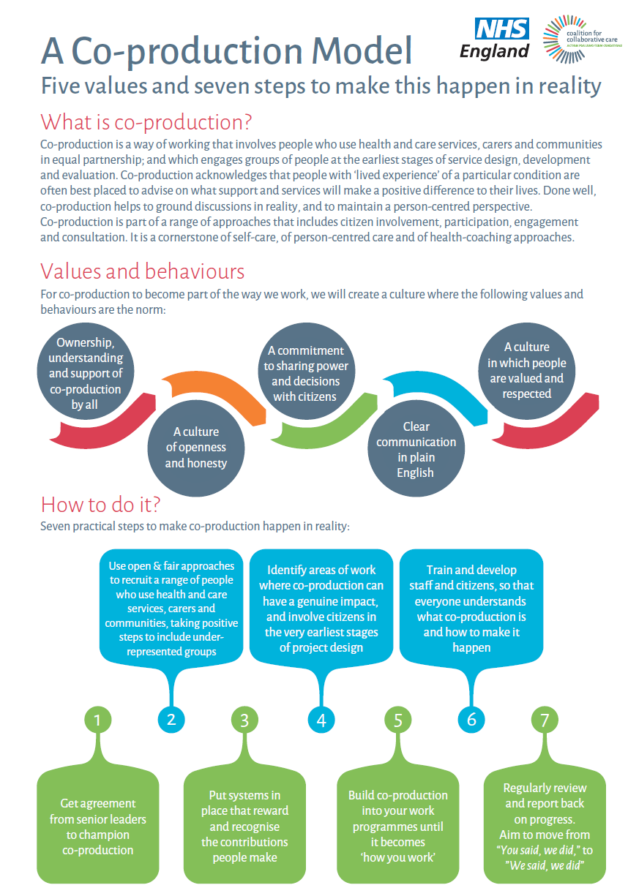
Co-production - strategic level

Slide 19
From challenge to opportunity
What’s your best experience of being involved in making something happen or achieving positive change when it wasn’t part of your job?
(If that’s never happened, think of a time when you involved people with lived experience in bringing about change)
What happened? Who was involved?
What were the magic ingredients that made it work so well?
If you could wave a magic wand, what three things would you wish for to ensure that health coaching and other asset-based approaches became the norm where you work?

Slide 20
How you can get involved
For deep, large-scale, sustainable change to happen we need to creative a collective, powerful movement.
Join us by visiting our website at:
www.coalitionforcollaborativecare.org.uk
Share your stories with us
Engage with our partners at a regional and local level
Help us spread the word

